Slide 1
Word World
By:
1602-20-737-124 K. Anirudh
1602-20-737-145 S. Manmateja
1602-20-737-148 A. Nithin

Slide 2
Action-wise use cases
Player | System
Player details | Takes the player details as input
Select level | Displays menu and prompts the player to choose a level
Randomize | Displays a random question
Answer | Prompts the user to enter the answer
Evaluates | Evaluates the answer provided by the player
Update score | Updates the player score after evaluation
View score | Displays the current score of the player
Next | Displays the next question

Slide 3
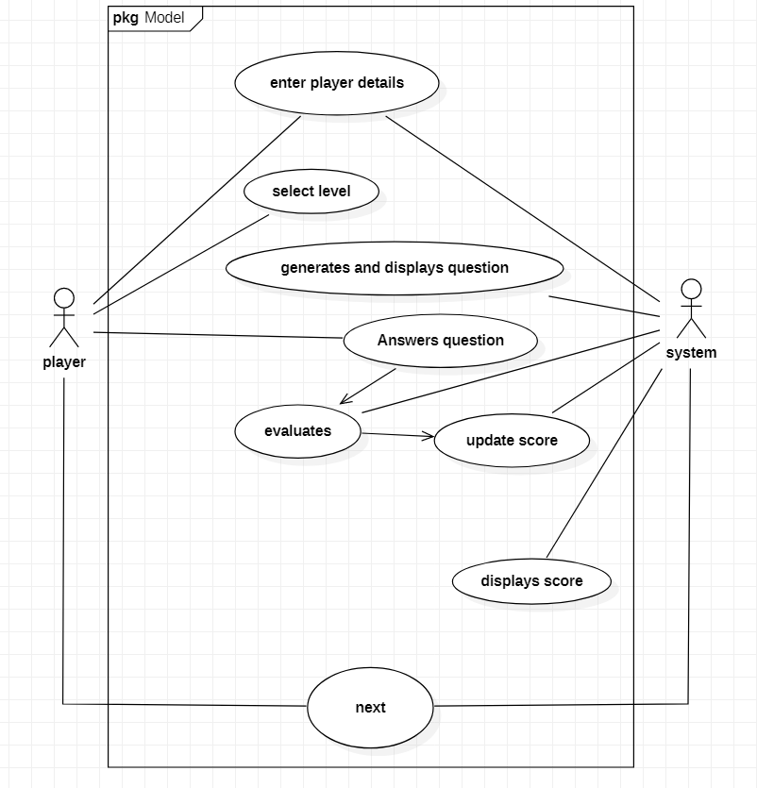
Use case diagram

Slide 4
Use case descriptions
Use case 1:
Use case 01:
Name : select level
Actors : Player
Description : Allows the player to select a level
Pre-conditions : Player details
Post-conditions : A level must be selected
Main flow:
Player | System
 | 1. Displays a menu
2. Player selects a level
 | 3. Validates the input and proceeds to next step

Slide 5
Use case -02:
Name: generates question
Actors: System
Description: displays a question
Pre-conditions: selection of level
Main Flow:
Player | System
1. Clicks ‘start’ button
 | 2. Displays the question

Slide 6
Use case-03:
Name: Answer a question
Actors: Player
Description : The player answers the question
Pre-condition: Display of the question
Post-condition: response is given to the system
Main-Flow:
Player | System
 | 1. Prompts the user to enter the answer(word) for the given images
2. Player enters his answer

Slide 7
Use case-04:
Name: Evaluates
Actors: System
Description: System evaluates the answer given by player, if it is correct adds points to his score
Pre-conditions: User should give his response to the question
Post-conditions: updating score
Main-Flow:
Player | System
 | Evaluates the response given by the user 1.1: adds points for correct answer

Slide 8
Use case-05
Name: displays score
Actors: system
Description : Displays the current score of the player
Pre-condition : clicking save and next button
Post-condition : displaying the updated score
Main-Flow:
Player | System
 | 1. Displays the current score

Slide 9
Use case-06
Name: Save and Next
Actors: Player, System
Description: prompts the player to go to next question
Pre-condition: Answering the previous question
Post-condition: system choosing the next question
Main Flow:
Player | System
1. Clicks the save and next button if player wants to go to the next question
 | 2. Randomly chooses the question and displays

Slide 10
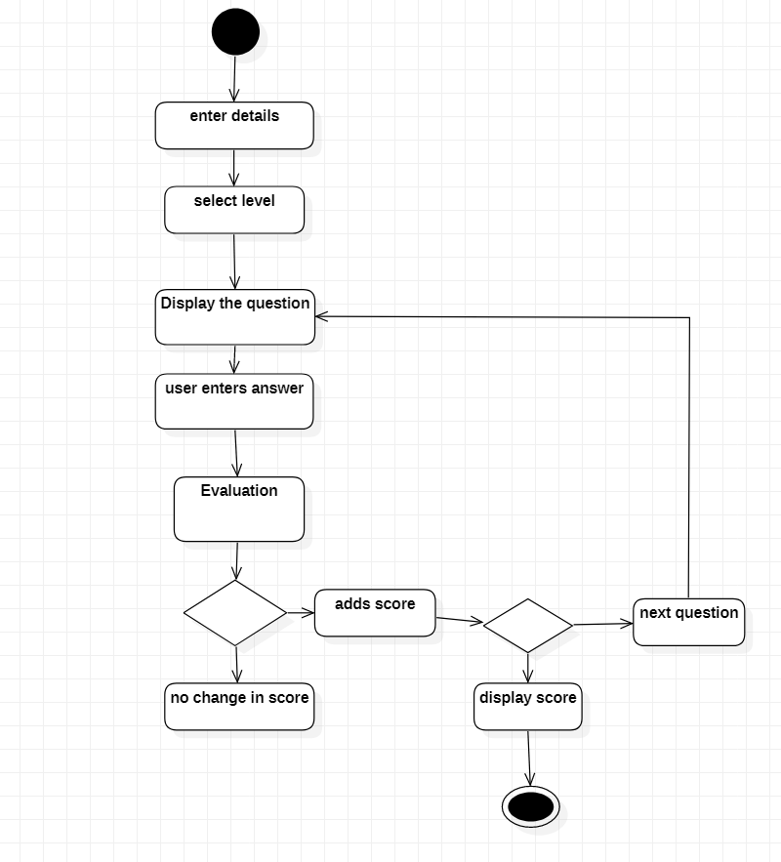
Activity Diagram

Slide 11
Thank you

